Slide 1
BIRLA VISHVAKARMA MAHAVIDYALAYA (Engineering College) (An Autonomous Institution) Information Technology Department AY: 2022 -23 4IT31 – Project I
Gender RECOGNITION & Age DETECTION USING HUMAN FACIAL FEATURES
Guide: Group Members: Dr. zankhANA SHAH Jayraj Malamdi(19IT424)
BHAVYA DAVE (19IT433)
SHREY BHATT (19IT463)
DHRUV SHAH (19IT425)

Slide 2
Outline of the presentation
Objective
Scope
Introduction
Literature Survey
ER diagram/Use-case diagram/Sequence diagram/DFDs
Description of Modules & Functionalities
Results/Screenshots
Demonstration

Slide 3
Objective
The project's objective is to create a gender and age predictor that uses deep learning & machine learning concepts on the Adience Dataset to roughly guess the gender and age of the person(face) in live feed using a flask-made web application from live video feed.
The predicted gender may be one of ‘Male’ and ‘Female’, and the predicted age may be one of the following ranges-
(0– 3), (4 – 6), (8 – 13), (15 – 20), (25 – 32), (35 – 43), (45 – 53), (60 – 150)

Slide 4
Scope
It is already known that predicting age and gender of a person by just seeing its face is a difficult task for even a human, for example, if a person is wearing glasses and has long hair and no facial hair, then it’s hard for a human to determine its age and gender.
Hence, we have used age brackets instead of using a continuous age label. There are numerous problems that we faced during this research work.
i) First is illumination i.e., not adequate lighting in the space at time of input (video/image acquisition).
ii) Second is foreign objects (like glasses, masks, hair, etc.) in between the subject face and camera causes poor results [1].
iii) Third is Frontal Face i.e., face rotations in and out of planes affects the results, hence, subject should face the camera directly instead of having a sideways gaze.

Slide 5
Introduction
One of the active study fields in recent years is the extraction of information from the human face. Numerous investigations on the identification of the most prevalent face variety, including age and gender, have been done.
The approach for automatically determining a person's age and gender from their face is suggested in this paper and is based on convolutional neural networks and support vector machines.
The four steps of this method are face detection, pre-processing, feature extraction, and classification.
A variety of convolutional neural networks have been trained to detect faces in live feed and also determine their age and gender are part of our system. Our model, was trained using Adience benchmark dataset for age and gender prediction available on Kaggle, which has produced positive results.

Slide 6
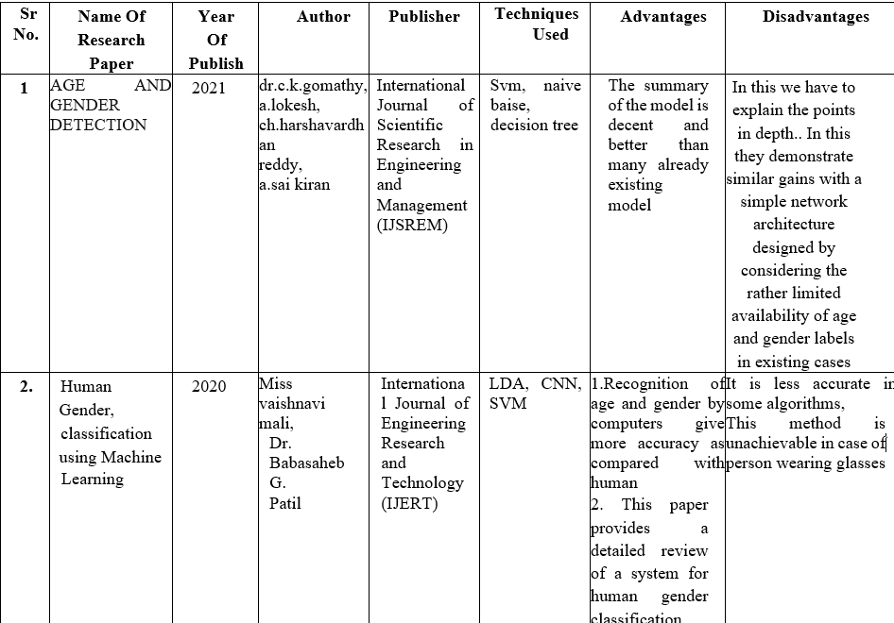
Literature Survey :

Slide 7
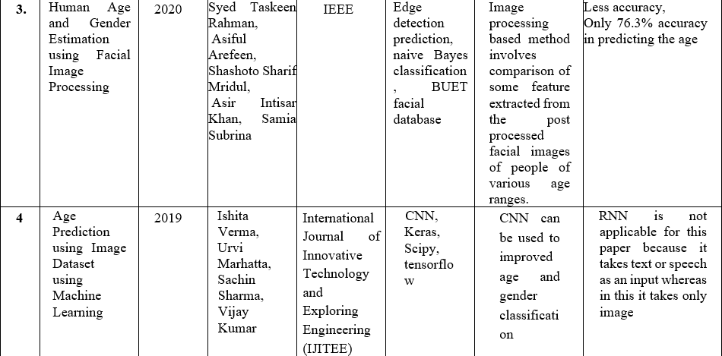

Slide 8
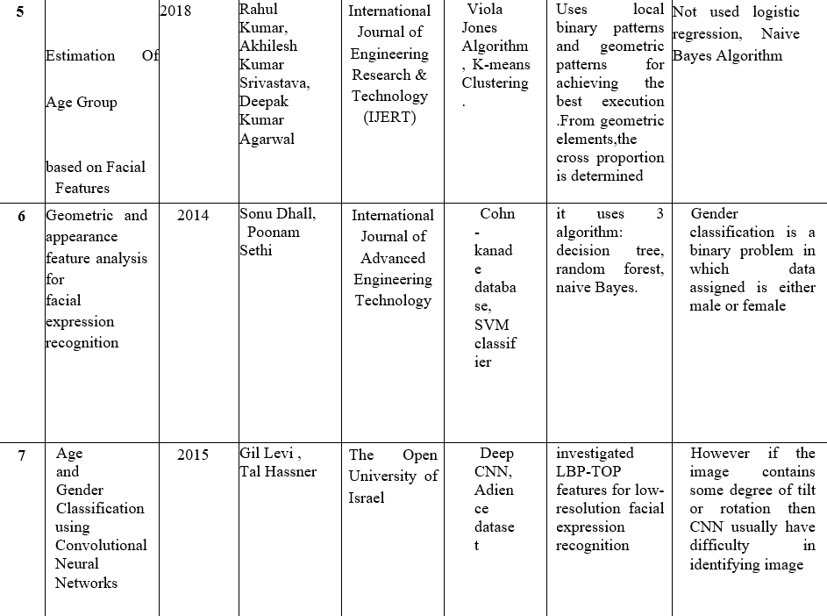

Slide 9
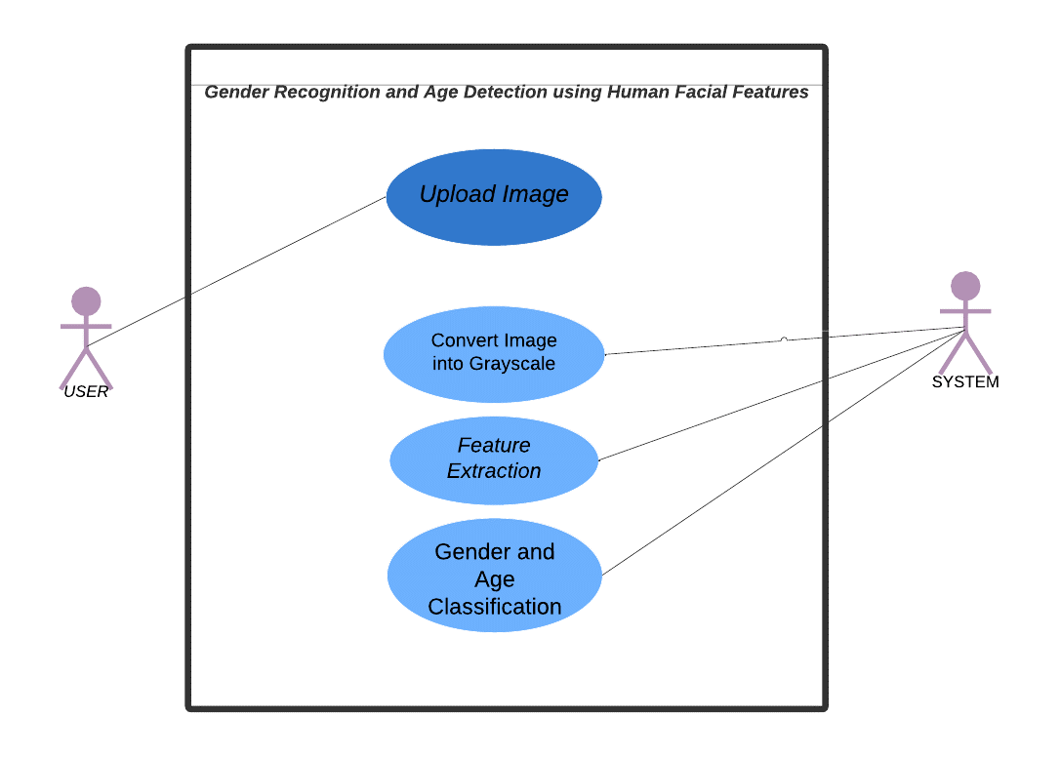
Use- Case Diagram

Slide 10
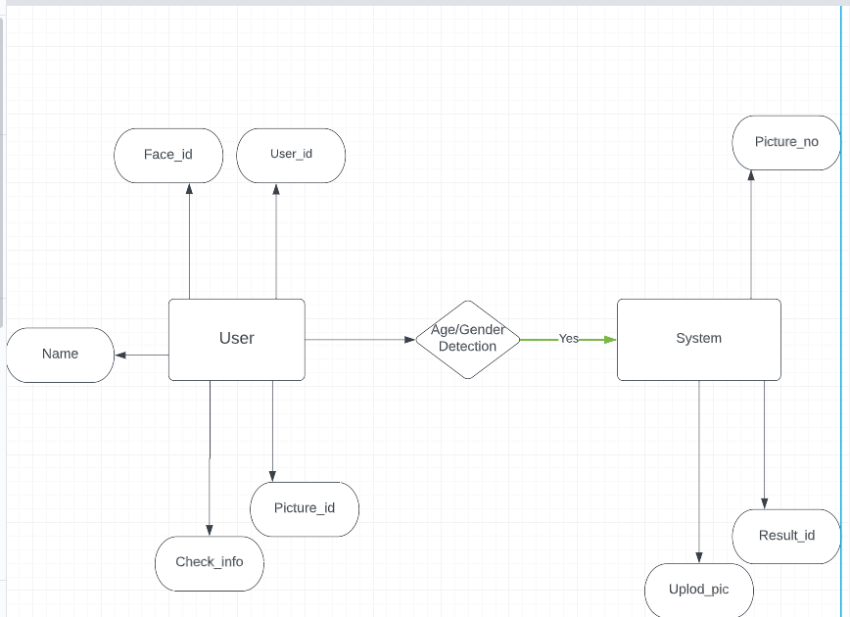
ER- DIAGRAM

Slide 11
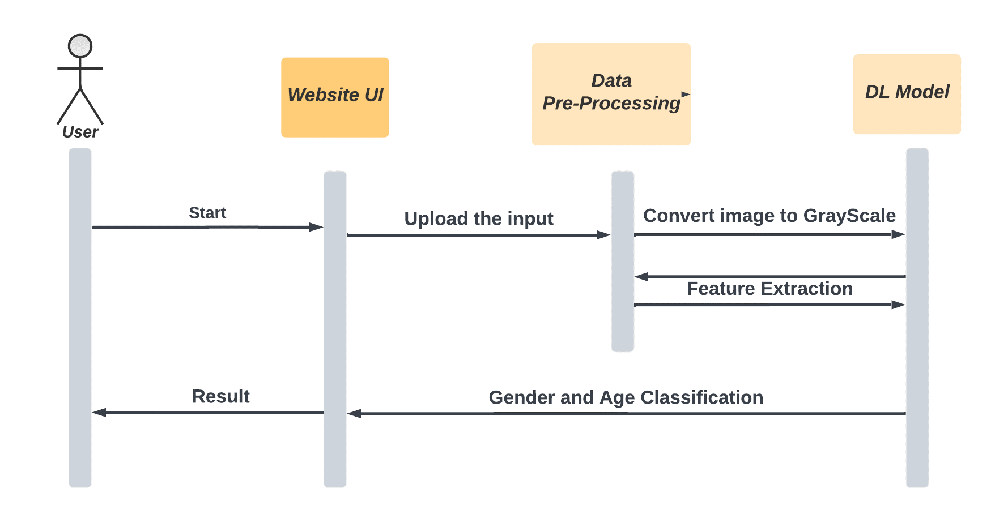
Sequence Diagram

Slide 12
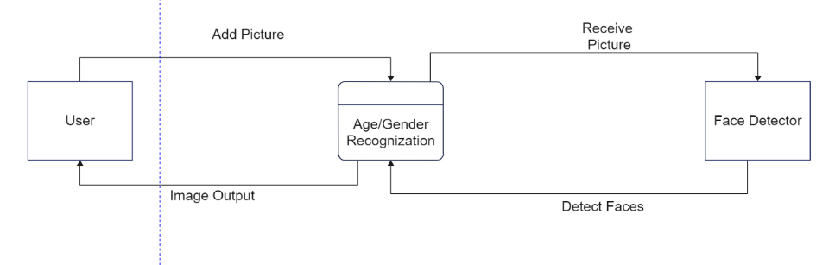
DATA FLOW DIAGRAM
Level 0 :

Slide 13
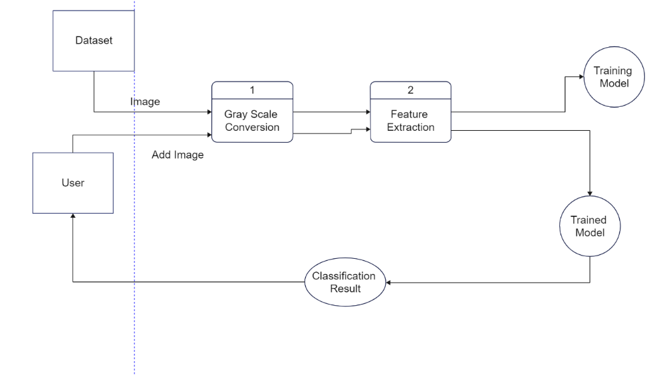
Level 1 :

Slide 14
Modules Description
Project Modules are :
Data Acquisition
Face Detection
Data Pre-processing
Model Building
Model Training
Model Evaluation

Slide 15
1) Data Acquisition :
The Adience benchmark dataset is selected as our dataset for detecting the age and gender in images. The entire Adience collection includes 26,580 256×256 color facial images of 2,284 subjects, with eight age group classes:
(0– 2), (4 – 6), (8 – 13), (15 – 20), (25 – 32), (38 – 43), (48 – 53), (60 –100)
Images from smart phones that are automatically uploaded to network albums make up the Adience dataset. These photos are entirely unrestricted because they were taken under various conditions; they haven't been artificially altered before being uploaded. To align faces, we employ the in-plane face aligned technique. A typical five-fold, subject-exclusive cross-validation methodology is used to test for age classification, and the results are averaged to get the final age group classification.

Slide 16
Age | Male | Female | Total
4—6 | 906 | 1234 | 2140
8—12 | 934 | 1190 | 2124
15-20 | 734 | 908 | 1642
25-32 | 2308 | 2696 | 5004
38-43 | 1294 | 999 | 2293
48-53 | 392 | 428 | 820
60-100 | 376 | 496 | 872
38-48 | 2 | 4 | 6
35 | 123 | 170 | 328
3 | 8 | 10 | 21
55 | 33 | 43 | 131
58 | 2 | 3 | 63
22 | 60 | 89 | 171
13 | 66 | 102 | 181
45 | 55 | 33 | 133
36 | 24 | 12 | 72
None | 455 | 293 | 748
Fig: Adience Benchmark Dataset Analysis

Slide 17
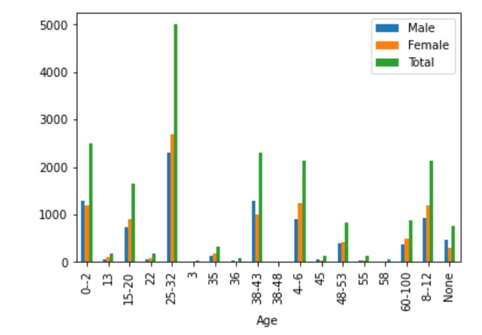
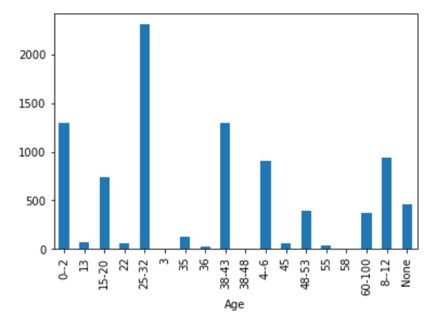
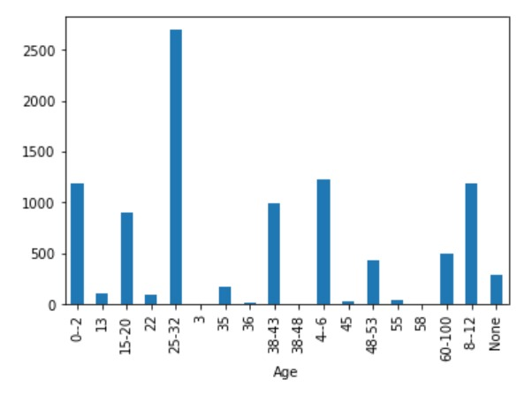
Dataset specification in Bar graphs :
Figure : Combined Age and Gender Dataset
Figure : Age Dataset for Male
Figure : Age Dataset for Female

Slide 18
2) Face Detection :
First created a function named “cropPhoto” which crops the photo.
For face detection we have used, MTCNN(multi-Task Cascaded CNN). It is capable of recognizing other facial features such as eyes & mouth, called Landmark detection.
The network uses a cascade structure with three networks:
First the image is rescaled to a range of different sizes (called an image pyramid), then the first model (Proposal Network or P-Net) proposes candidate facial regions, the second model (Refine Network or R-Net) filters the bounding boxes, and the third model (Output Network or O-Net) proposes facial landmarks.
The model is called a multi-task network because each of the three models in the cascade (P-Net, R-Net and O-Net) are trained on three tasks, e.g., make three types of predictions they are: face classification, bounding box regression, and facial landmark localization.

Slide 19
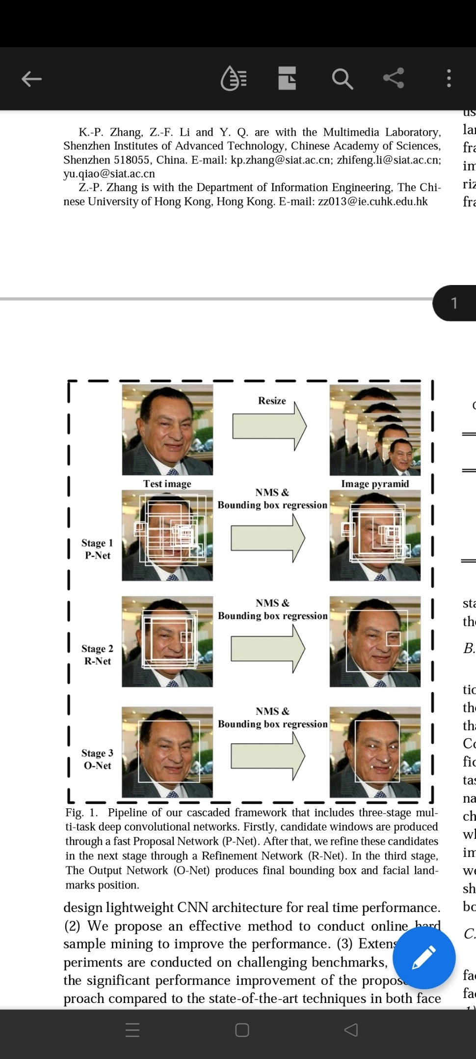
This image is taken from the paper[8], which provides a helpful summary of the three stages from top-to-bottom and the output of each stage left-to-right.
The three models are not connected directly; instead, outputs of the previous stage are fed as input to the next stage. This allows additional processing to be performed between stages; for example, non-maximum suppression (NMS) is used to filter the candidate bounding boxes proposed by the first-stage P-Net prior to providing them to the second stage R-Net model.
Fig : MTCNN process

Slide 20
3) Pre - Processing :
A) Data Augmentation:
Data augmentation is the technique of creating additional data points from current data in order to artificially increase the amount of data. In order to amplify the dataset, this may involve making small adjustments to the data or utilizing machine learning models to produce new data points in the latent space of the original data. Practically every state-of-the-art deep learning application, including object identification, picture classification, image recognition, natural language understanding, semantic segmentation, and others, makes extensive use of data augmentation techniques. By creating fresh and varied examples for training datasets, augmented data is enhancing the efficiency and outcomes of deep learning models.

Slide 21
Data Normalization
The technique of projecting picture data pixels (intensity) to a preset range, such as [0,1], is also known as data re-scaling. This is frequently applied to many data types, and you should normalize them all so that you can use the same algorithms on them. Normalization is frequently used to convert a picture's pixel values into a more familiar or pleasant sensation. The benefits of using Normalization are :
Fairness among all photos - For instance, when all images are scaled to the same range, all images can contribute equally to the overall loss as opposed to when other images have high and low pixels ranges, which result in strong and weak loss, respectively.
Provides a standard learning rate- Rescaling aids in achieving a uniform learning rate for all photos because high pixel images need a low learning rate and low pixel images need a high learning rate.
Here, we have normalized our RGB images which are of data type uint8 and are in the range of [0, 255]. The new range will be [0, 1].

Slide 22
Dimensionality Reduction :
Scikit-learn Classifiers accepts the training features to be in 2D arrays, which means we can't feed RGB images directly into any scikit-learn classifier. To tackle this situation, we need to reshape or flatten the 3d RGB images into 1D array. But by simply flattening the an RGB image of shape 256x256x3, it will become an 1D array of shape 1x196608 which has a lot of features in it.
Due to higher dimension, the data becomes sparse due to which ML algorithm fails also Due to this complexity, the training time is increased exceedingly and the model will perform poorly
Hence it becomes very critical to reduce the number of factors or features to a few important ones to arrive at the right decision. This process is called Dimensionality Reduction.

Slide 23
PCA(Principal Component Analysis)
Here to tackle this problem, we performed dimensionality reduction technique by applying PCA (Principal Component Analysis) in SVM model.
Principal component analysis, or PCA, is a dimensionality-reduction method that is often used to reduce the dimensionality of large data sets, by transforming a large set of variables into a smaller one that still contains most of the information in the large set.
Here in our project, we have taken the first 500 components which covers up to 90% information when summed up the individual component's variance. This means we have successfully reduced 196608 features to just 500 features by losing only 10% of the information from the dataset.

Slide 24
Model Building
After the preprocessing is done, the dataset is split for train and test purposes. Test size is 20% of the train size.
We have created two models, first is using SVM algorithm and second is by using CNN model.
The features we have used for detecting Age and gender of human from images & live video feed are :
Gender classification :
GEOMETRIC BASED FEATURE EXTRACTION :
describe shape and location of facial components.
Find the coordinates of these facial points.
APPEARANCE BASED FEATURE EXTRACTION.

Slide 25
Age classification :
WRINKLE FEATURES :
estimate of the F5 characteristics can be carried out.
as age increases , wrinkles on face turn out to be clearer.
GEOMETRIC FEATURES :
It is based on calculating ratios between different measurements of facial features( e.g., Eyes, nose, mouth, chin, etc.)
distance values ratios

Slide 26
SVM Model
As the dataset has been prepared, now it's the time for training different classifiers and then choose the best one. We will be training classifiers with hyperparameter tuning. The performance of a model significantly depends on the value of hyperparameters.
GridSearchCV is the name of the package provided by Scikit-learn which is then used for hyperparameter tuning.
GridSearchCV is the process of performing hyperparameter tuning in order to determine the optimal values for a given model. Doing this manually could take a considerable amount of time and resources and thus we use GridSearchCV to automate the tuning of hyperparameters.
In our project we have created two different models, one for age and other for gender. Because SVM doesn’t support multiclass classification natively. It supports binary classification.
At last Model is saved and then the RAM is cleared. Now, the performance on the test dataset takes place.

Slide 27
CNN
We have made CNN model for age and gender i.e.; it is a multi-output model.
The CNN architecture contains two branches, one for age, other for gender. Each branch contains a sequence of Convolutional Layers.
The structure of our network :
The input shape of our network is : INPUT_SHAPE = (196, 196, 3) First, it contains a default set of hidden layers, which is called by “backbone function”.
The structure used in this network is defined as:
Conv2D -> Batch Normalization -> Pooling -> Dropout
Now, this default set output is connected to age and gender network.
The age and gender network uses activation “sigmoid”. At last, “build function” is used to assemble our multi-output model CNN

Slide 28
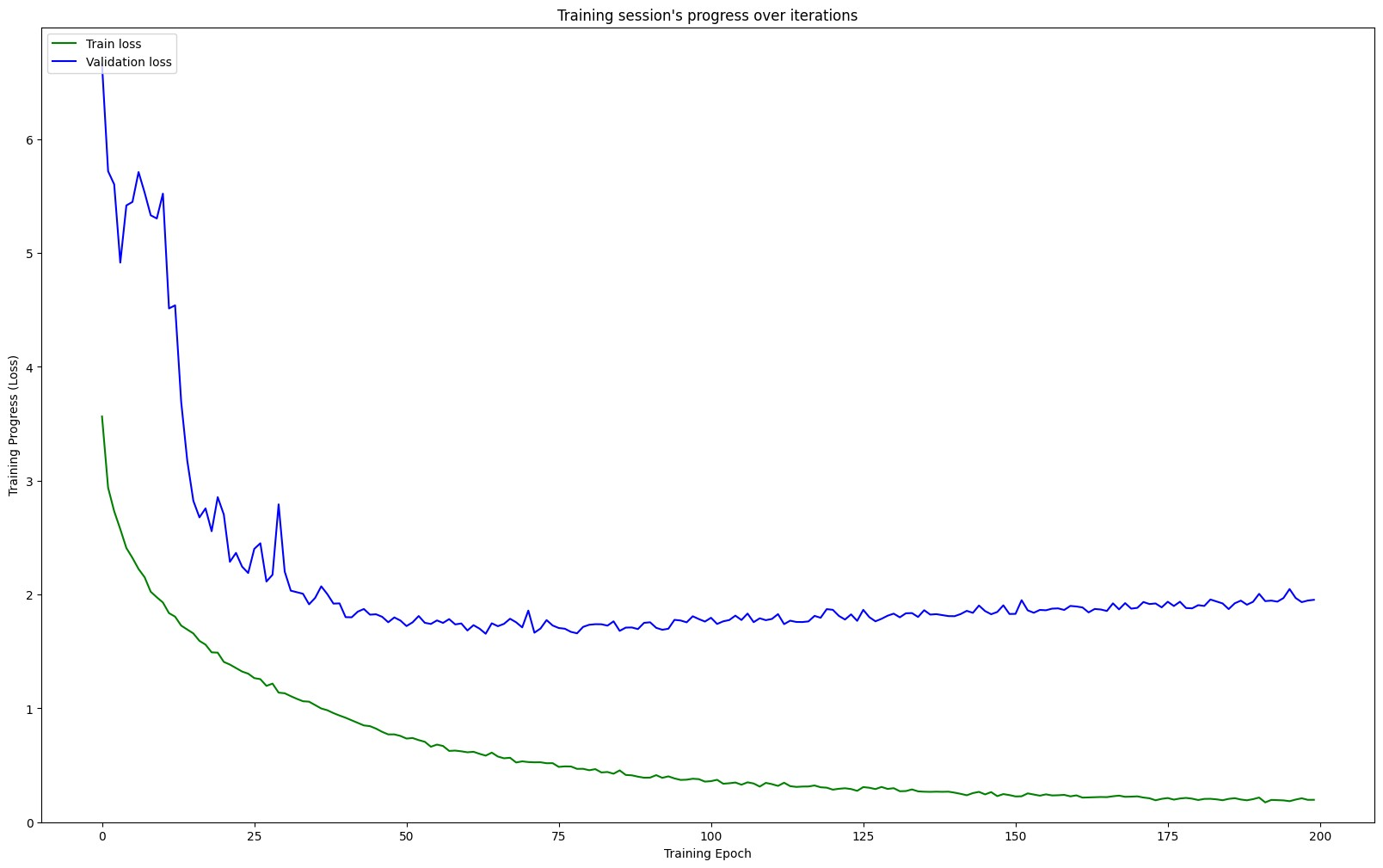
Model Evaluation
The testing accuracy and validation accuracy of our model are checked, model loss is noted, and the confusion matrix is plotted. The misclassified images count of each type is also determined.
Figure : Training Loss vs Validation Loss Plot

Slide 29
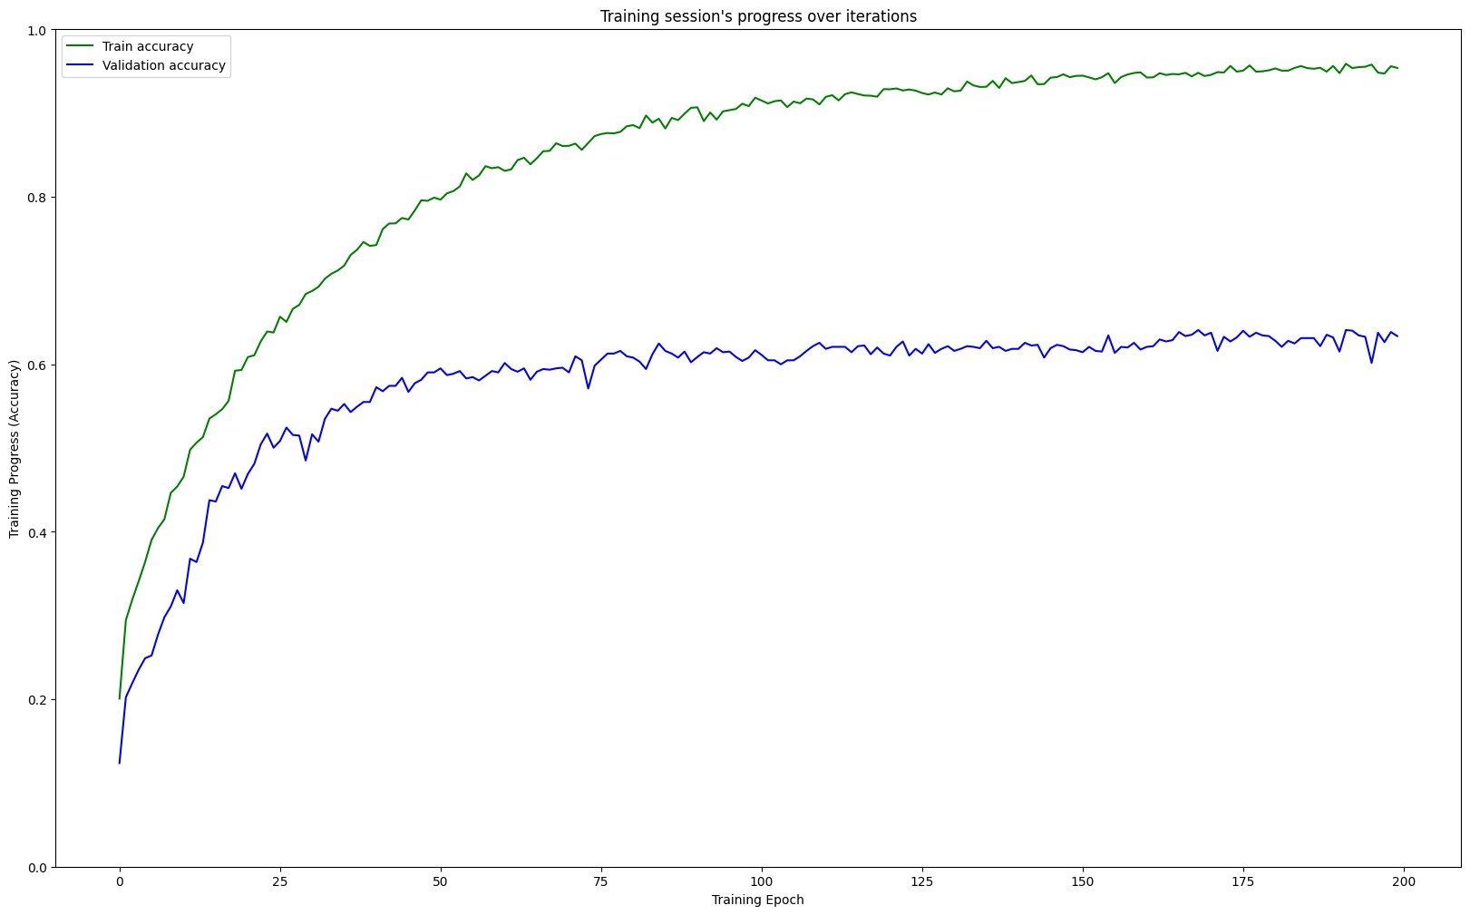
Figure : Training Accuracy vs Validation Accuracy for Age

Slide 30
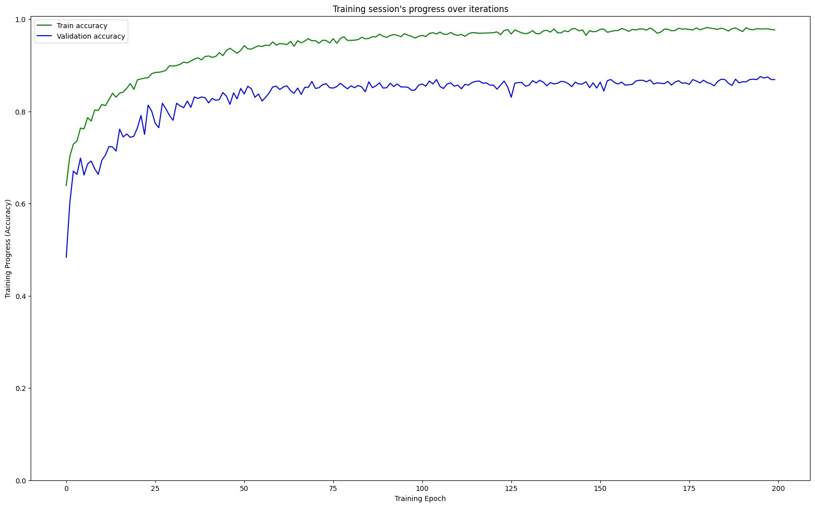
Figure : Training Accuracy vs Validation Accuracy for Gender

Slide 31
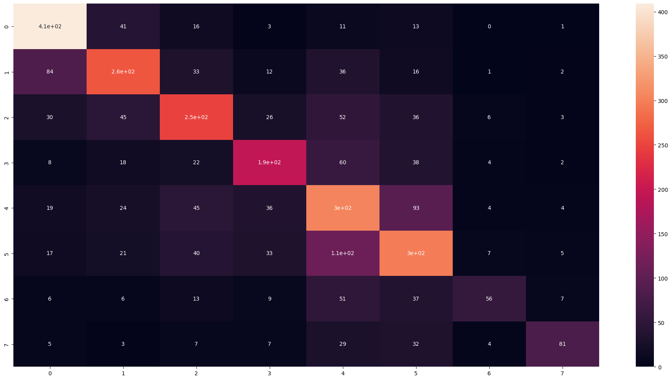
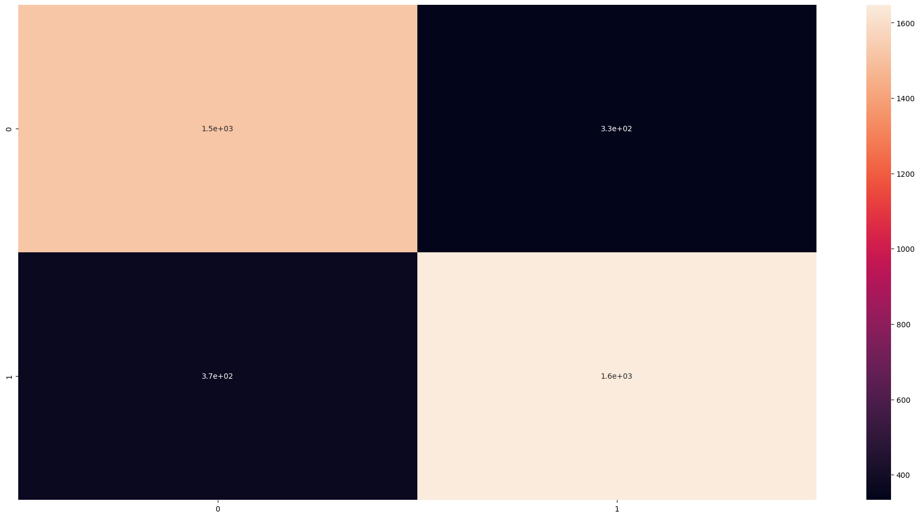
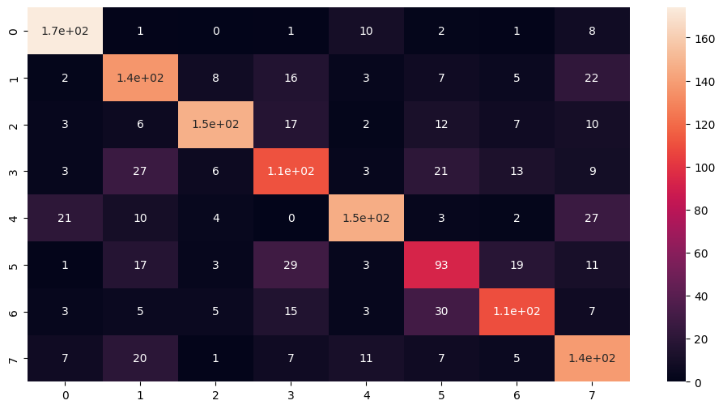
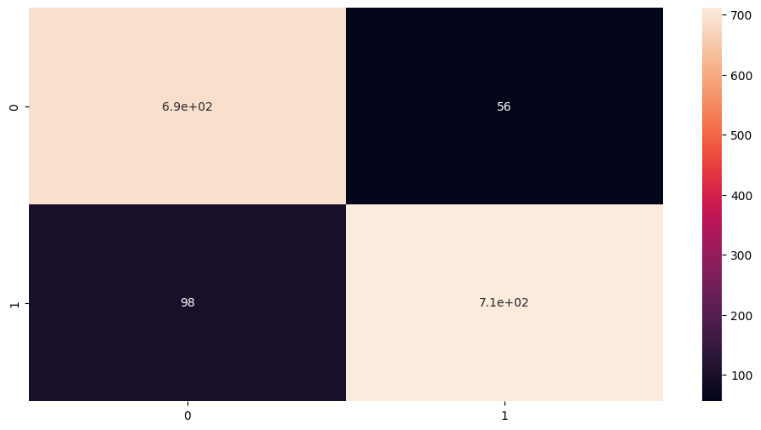
Confusion Matrix
Figure : Confusion Matrix of SVM gender
Figure : Confusion Matrix of CNN age
Figure : Confusion Matrix of CNN gender
Figure : Confusion Matrix of SVM age

Slide 32
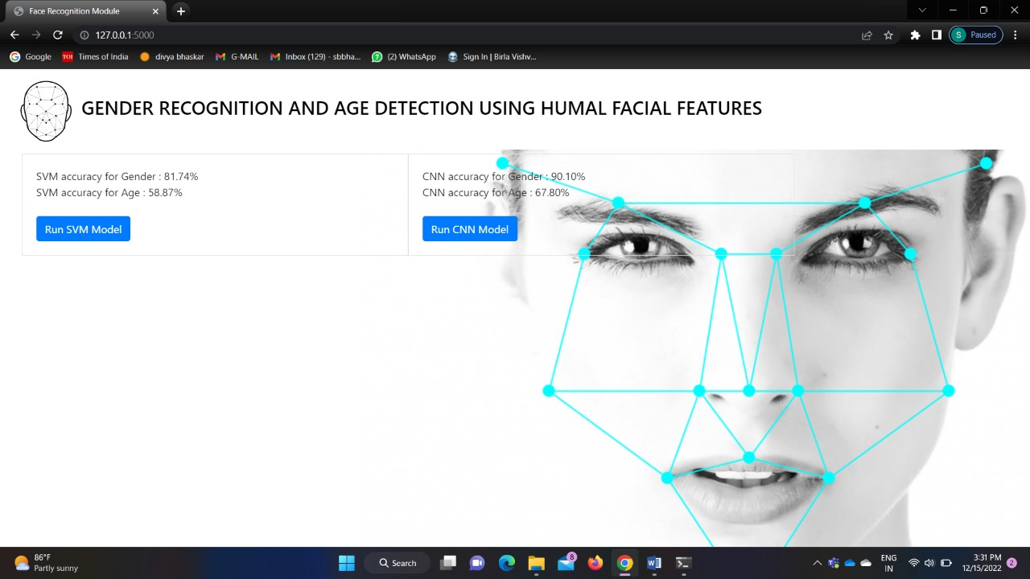
Result
Home Page of our Flask web app:

Slide 33
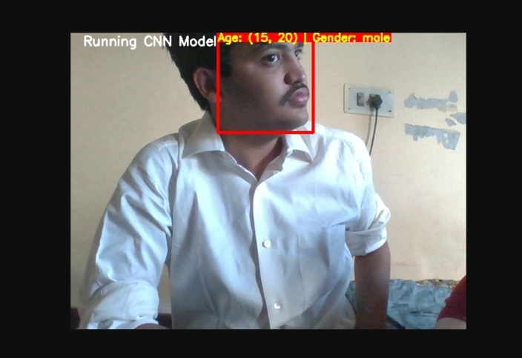
Testing using Use Case:

Slide 34
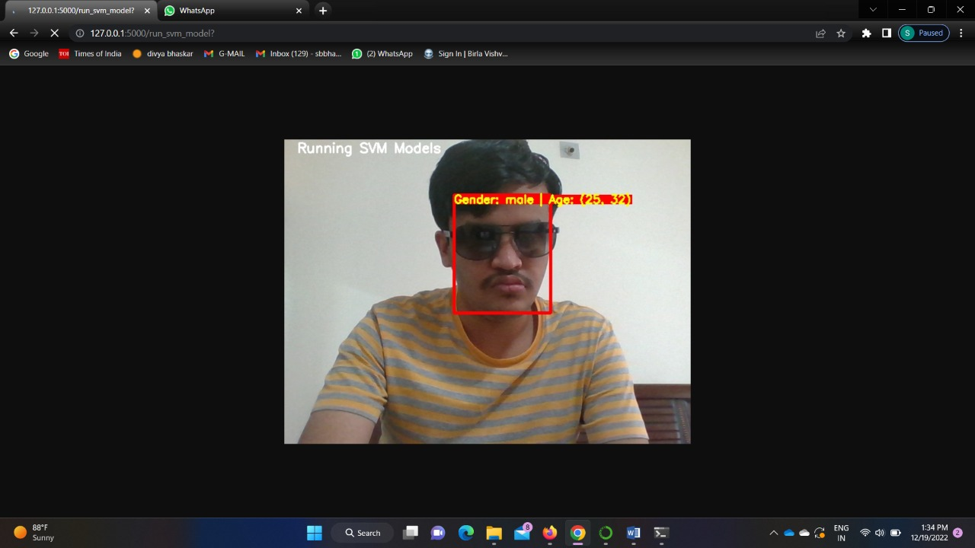
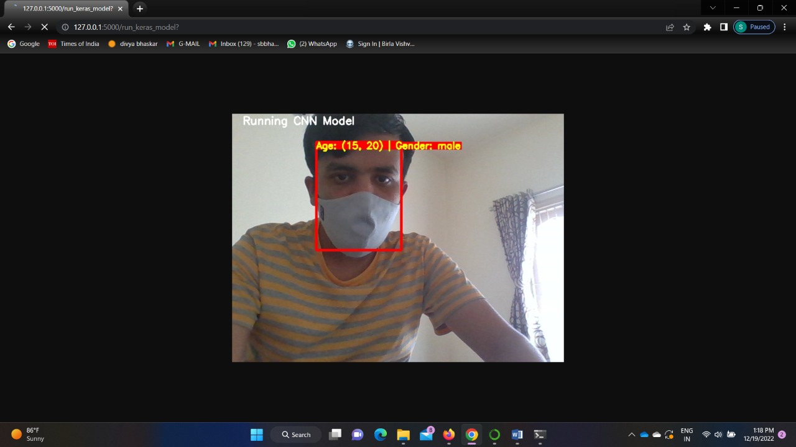
Fig : using CNN model
Fig : using SVM model

Slide 35

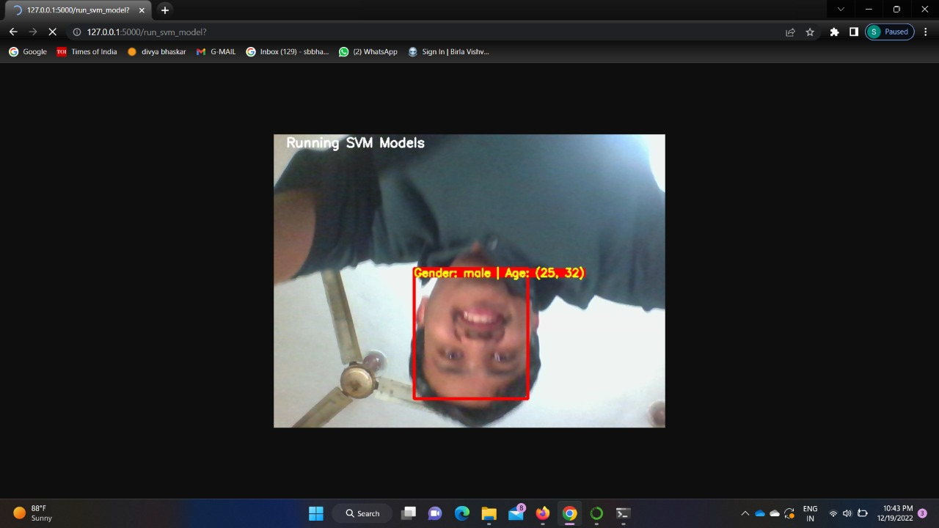

Slide 36
Thank You

